Slide 1
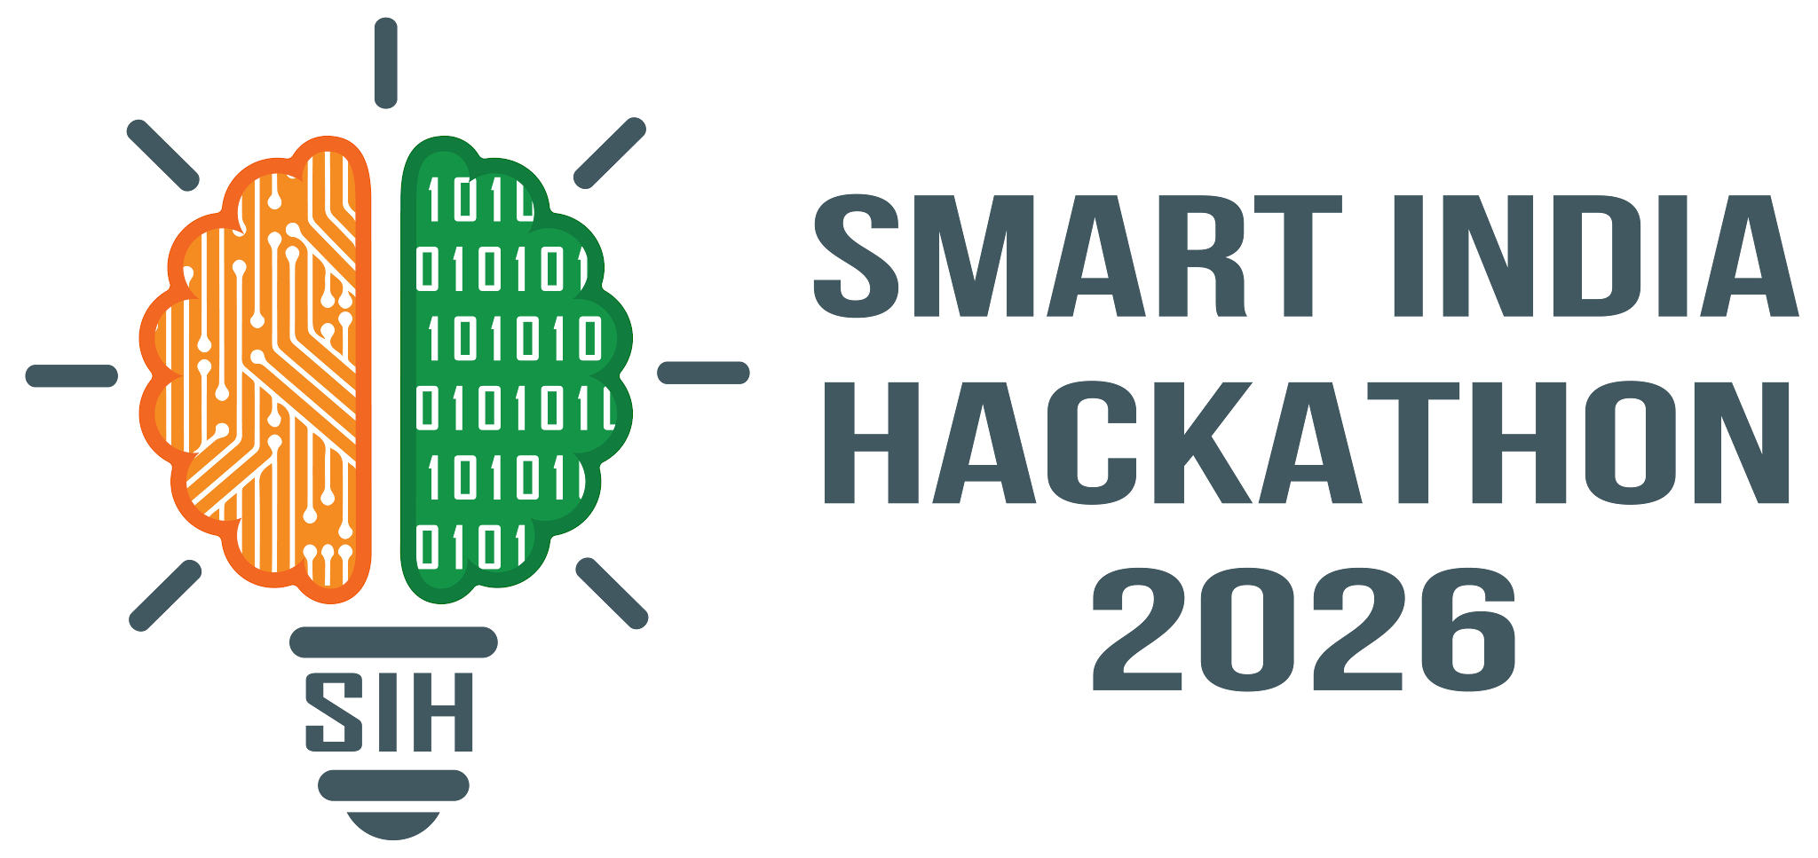

SMART INDIA HACKATHON 2026
TITLE PAGE
Problem Statement ID – 26018
Problem Statement Title - Intelligent Land Record Digitization and Validation System
Theme - Smart Automation
PS Category -software
Team ID -
Team Name – Terra Vault

Slide 2
TerraVault
IDEA TITLE
Problem Resolution :
IDEA / SOLUTION :
❖ Eliminates manual entry bottlenecks and errors, digitizing historical handwritten and damaged land records with 99.5%+ verified accuracy.
Implementation of an AI-powered Multilingual Land Record Digitization and Automated Cross-Validation Framework for legacy paper documents, handwritten registers, and cadastral maps.
❖ Resolves legacy land ownership disputes by cross-referencing mutation records,preventing duplicate entries, and streamlining citizen service delivery.
❖ Multilingual Indic OCR/HTR Engine for handwritten registers &
scanned PDFs across 10+ regional Indian languages
Unique Value Propositions (UVP) :
❖ Indic-HTR Transformer Model specialized in recognizing
vintage scripts, faded ink, and regional handwritten dialects
❖ LayoutLM-driven entity parsing automatically extracts
Khasra, Khata, Survey No., Landowner details, and Plot Area
❖ Active Learning Retraining Loop that continuously learns
from human verifiers to boost accuracy over time
❖ Automated business-rule validation engine performing cross-
database verification against central DILRMP & state LRMS portals
❖ Real-Time Cross-Database Validation API connecting
DILRMP, NGDRS, and State Revenue registries instantly
❖ Human-in-the-Loop (HITL) review GUI with field-level confidence
scoring for zero-error verification of low-confidence records
❖ Interactive State & District Executive Dashboards for
tracking digitization metrics, error statistics, and pending approvals
❖ Vectorized Cadastral Map georeferencing integrating extracted
survey boundaries directly into GIS & Bhu-Aadhaar (ULPIN)
❖ End-to-End Security & Immutable Audit Logging ensuring
tamper-proof metadata management with Role-Based Access
Control (RBAC)

Slide 3
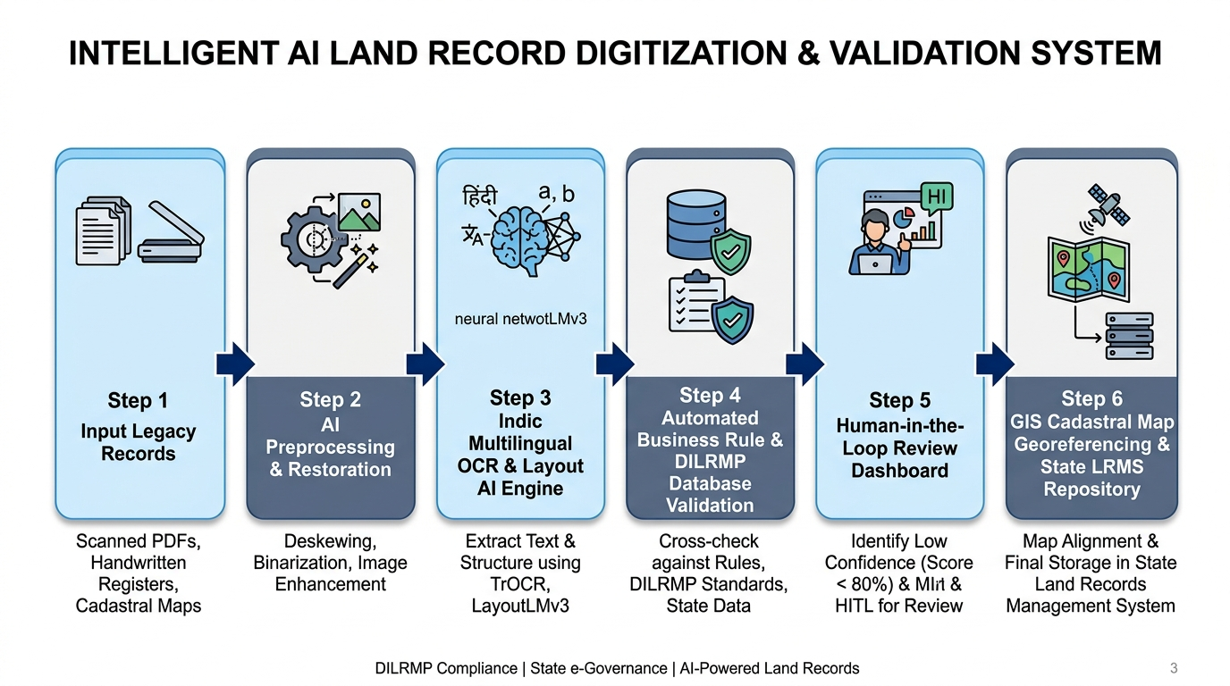
TECHNICAL APPROACH
TerraVault
Component-Wise Technology:
Methodology and Process for Implementation :
Component Layer | Technology Stack | Key Purpose
Document CV & Preprocessing | OpenCV, Real-ESRGAN, PIL | Image deskewing, binarization & noise cleanup
Multilingual Indic OCR / HTR | TrOCR, LayoutLMv3, Indic-BERT | Multilingual printed & handwritten text extraction
Rule Engine & Validation | FastAPI, Celery, PyDantic | DILRMP / LRMS cross-verification & duplicate check
GIS & Cadastral Mapping | GeoServer, PostGIS, Bhuvan API | Map vectorization & Bhu-Aadhaar (ULPIN) overlay
Web UI & Security | React.js, PostgreSQL, Docker | Human-in-the-Loop review & secure cloud backend

Slide 4
FEASIBILITY AND VIABILITY
TerraVault
Feasibility Analysis, Potential Challenges & Mitigation:
Technical Feasibility:
Potential Challenges & Risks | Strategies for Overcoming Challenges
1. Damaged & Faded Legacy Registers Poor scan quality, ink bleed, physical paper wear. | AI Super-Resolution & Preprocessing: Real-ESRGAN & adaptive binarization restore faded ink before OCR.
2. Complex Regional Indic Scripts Varied handwriting styles and regional dialects. | HITL & Active Learning: Low-confidence fields (<80%) trigger human review; edits retrain AI models iteratively.
3. Data Security & Record Tampering Risk of unauthorized edit of sensitive land records. | RBAC & Immutable Audit Trail: AES-256 encryption, OAuth2 auth, and audit logs track every document view and edit.
4. Integration with Legacy Systems Inconsistent API schemas across state LRMS portals. | Modular REST API & Adapters: Standardized API abstraction layer for plug-and-play integration with DILRMP/GIS.
Built on proven open-source AI frameworks (TrOCR,
LayoutLMv3, OpenCV) and scalable spatial databases
Financial Feasibility:
Reduces manual digitization turnaround and costs by >80%,
offering high ROI for government departments.
Operational Feasibility:
Integrates into revenue workflows with Human-in-the-Loop
(HITL) review safety net for zero-error guarantees.
Policy Alignment:
100% compliant with DILRMP, NGDRS, and Bhu-Aadhaar
(ULPIN) national land modernization standards.

Slide 5
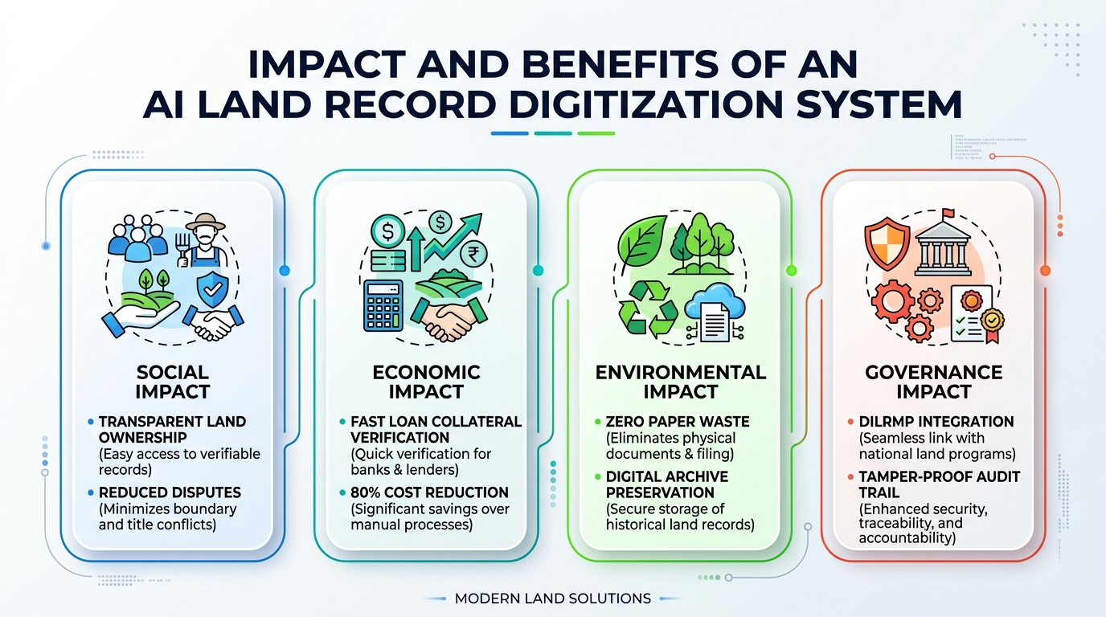
IMPACT AND BENEFITS
TerraVault
Potential Impact on Target Audience:
Citizens & Rural Landowners:
Instant Digital Access: 1-click retrieval of verified 7/12, Khasra,
and Khatauni land records.
Empowerment & Dispute Reduction: Transparent title ownership
protects farmers from land grabbing and lengthy legal disputes.
Land Revenue Department (DoLR / DILRMP):
85%+ Reduction in Turnaround Time: Eliminates manual data
entry backlogs across revenue offices.
Zero-Error Data Accuracy: 99.5%+ accuracy guaranteed via
Human-in-the-Loop AI verification.
Banks & Financial Institutions:
Rapid Collateral Verification: Instant verification of land titles
speeds up agricultural and property loan approvals.

Slide 6
RESEARCH AND REFERENCES
TerraVault
Government Frameworks & Official Standards:
Core AI, Computer Vision & NLP Research Papers:
❖ Digital India Land Records Modernization Programme (DILRMP)
❖ TrOCR (Transformer-based Optical Character Recognition)
Department of Land Resources (DoLR), Ministry of Rural
Development — https://dilrmp.gov.in
Microsoft Research (arXiv:2109.10282)
📄 End-to-end transformer architecture for printed &
Handwritten Indic text recognition.
❖ National Generic Document Registration System (NGDRS)
❖ LayoutLMv3 (Multimodal Pre-training for Document AI)
Centralized Property Registration Portal — https://ngdrs.gov.in
Microsoft Research (arXiv:2204.08387)
📄 Multimodal text & visual layout parsing for Khasra,
Khatauni & cadastral documents.
❖ Unique Land Parcel Identification Number (ULPIN / Bhu-Aadhaar)
DoLR Technical Guidelines & Spatial Mapping Standards for
14-Digit Land Parcel IDs
❖ Indic-BERT & IndicNLP Language Suites
❖ ISRO Bhuvan Geo-Spatial Platform
AI4Bharat, IIT Madras — 🌐 Website: ai4bharat.org
📄 Multilingual natural language processing supporting 22
regional Indian languages.
Indian Space Research Organisation (ISRO)
Land Portal — https://bhuvan.nrsc.gov.in
❖ Real-ESRGAN (Super-Resolution for Document Restoration)
Tencent ARC (arXiv:2107.10833)
📄 Generative AI model for restoring faded ink, removing
paper noise & enhancing illegible registers.

